Slide 1
Web Application Development
CSS

Slide 2
Outlines
Bootstrap CSS
Page layouts using bootstrap CSS

Slide 3
What is bootstrap CSS?
Bootstrap is a free and open-source front-end framework for designing websites and web applications.
Bootstrap is a free front-end framework for faster and easier web development that helps you to create a responsive front-end design.

Slide 4
Why we need to use Bootstrap?
Easy to use:
Anybody with just basic knowledge of HTML and CSS can start using Bootstrap
Responsive features:
Bootstrap's responsive CSS adjusts to phones, tablets, and desktops
Mobile-first approach:
In Bootstrap 3, mobile-first styles are part of the core framework
Browser compatibility:
Bootstrap is compatible with all modern browsers (Chrome, Firefox, Internet Explorer, Edge, Safari, and Opera)

Slide 5
Bootstrap selectors
Bootstrap contains wide range of selectors. Some very common selectors in bootstrap are as following
Bootstrap Grid System
Bootstrap typography
Bootstrap Tables
Bootstrap buttons
Bootstrap Pagination
Bootstrap Navbar

Slide 6
Creating shared layout using bootstrap
For this purpose visit
https://maxcdn.bootstrapcdn.com/bootstrap/3.3.7/css/bootstrap.min.css
https://ajax.googleapis.com/ajax/libs/jquery/3.3.1/jquery.min.js
https://maxcdn.bootstrapcdn.com/bootstrap/3.3.7/js/bootstrap.min.js
Copy all three files into your local disk named: bootstrap.min.css, jquery.min.js and bootstrap.min.js

Slide 7
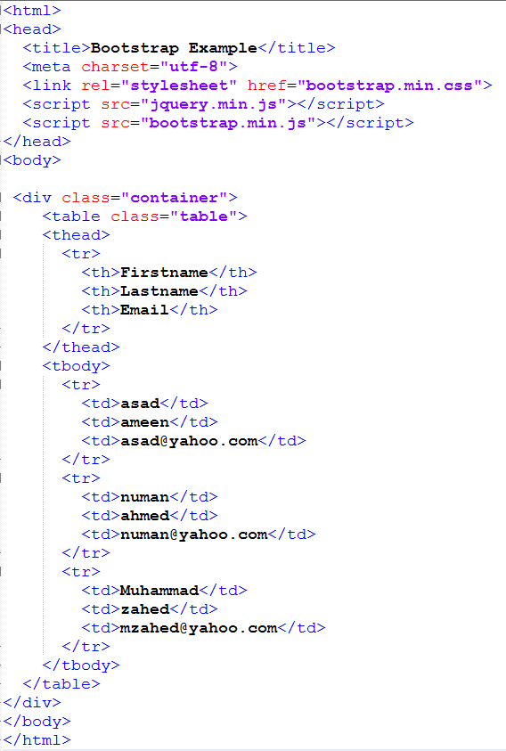
Bootstrap table Example

Slide 8
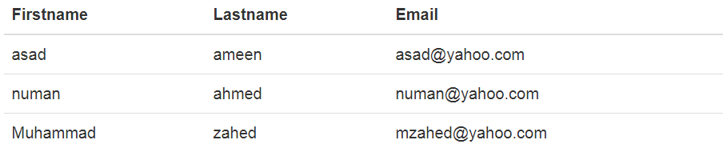
Example
Output

Slide 9
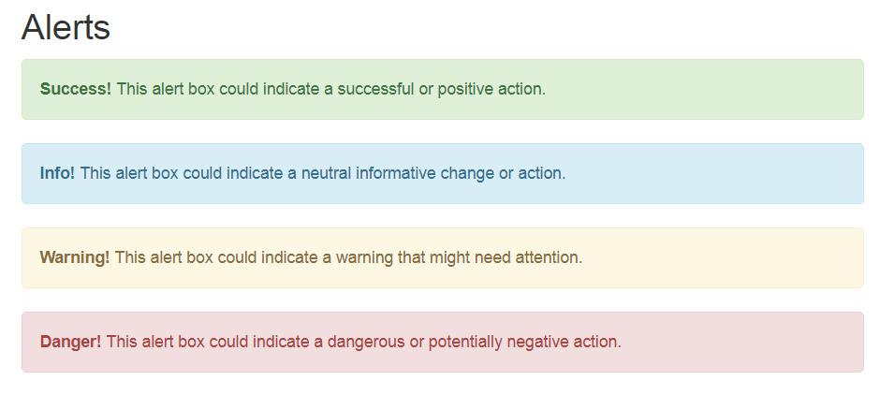
Bootstrap Example
Alert boxes are used to notify about alert messages. For example

Slide 10
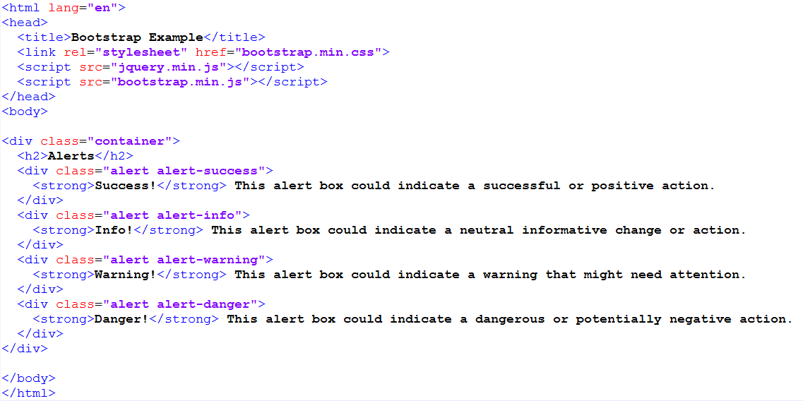
Bootstrap Example

Slide 11
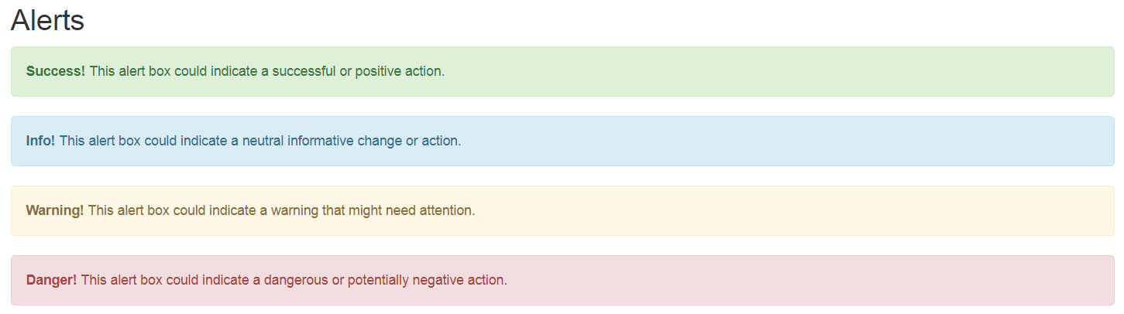
Bootstrap example
Output

Slide 12
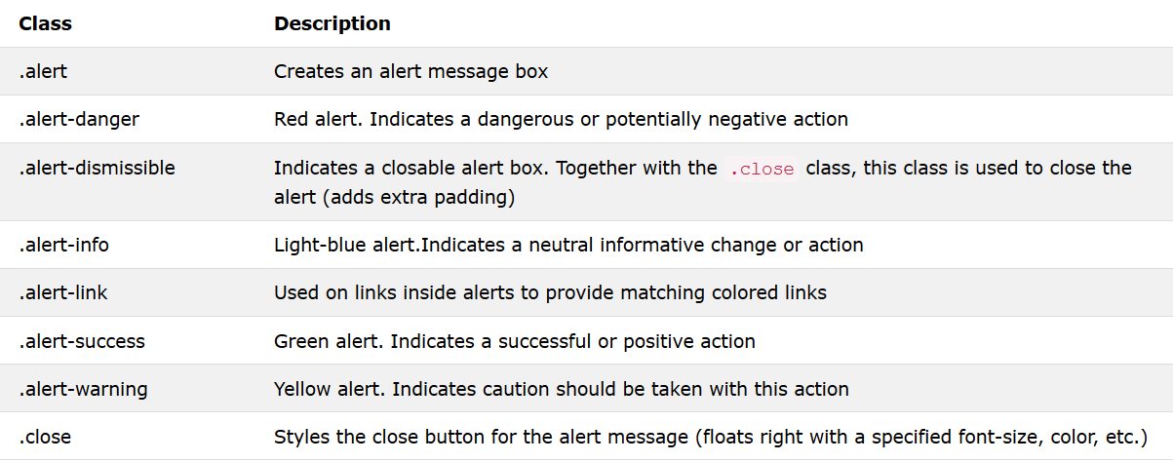
Bootstrap example
List of Bootstrap alert classes

Slide 13
Bootstrap Grid Example
Bootstrap Grid
Bootstrap Grid system allows you to create different size of columns in your application such as:
See Next Page

Slide 14
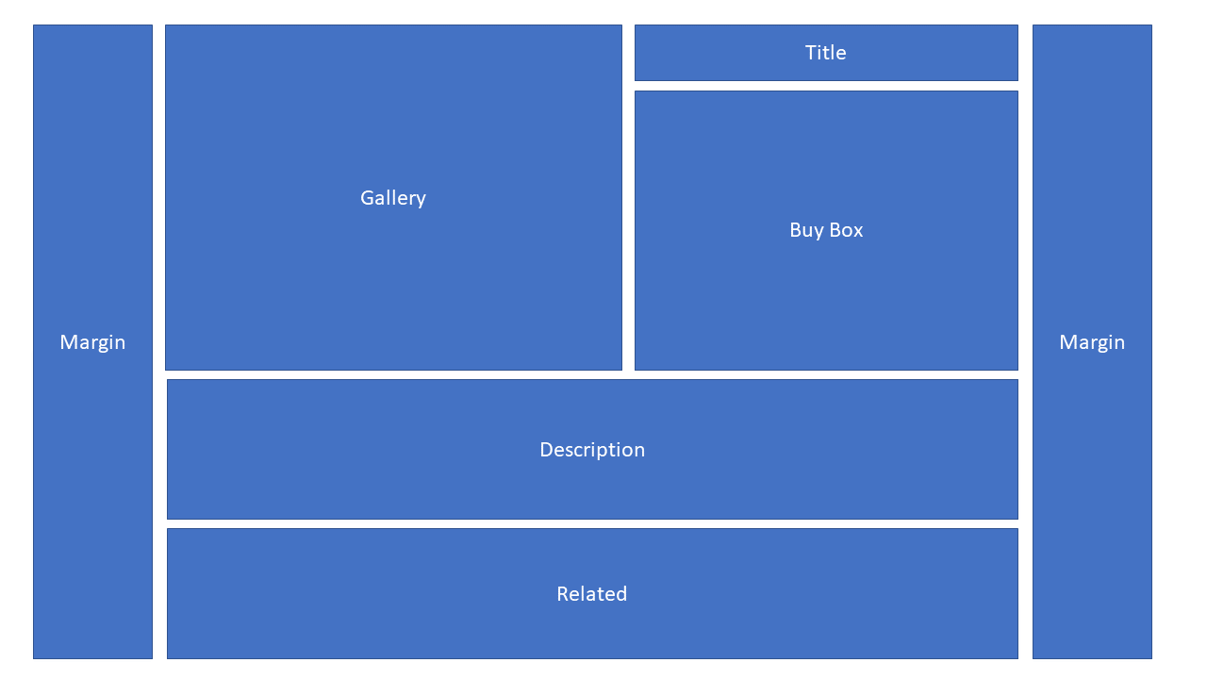
Bootstrap Grid Example

Slide 15
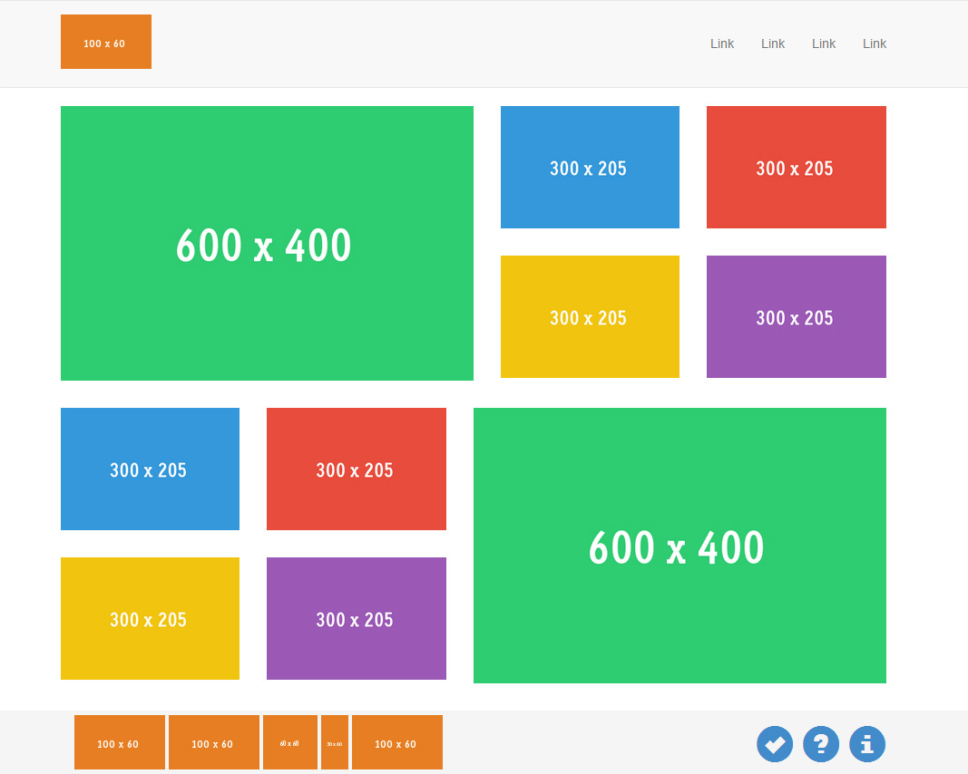
Bootstrap Grid Example

Slide 16
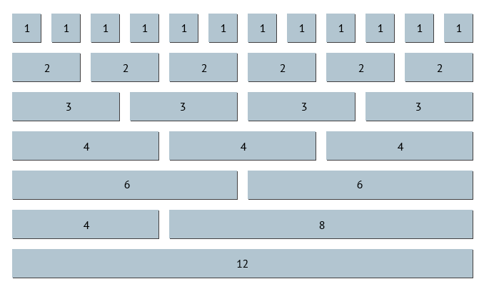
Bootstrap Grid Example

Slide 17
Bootstrap Grid
Bootstrap Grid Example
The Bootstrap grid system has four classes:
xs
for phones - screens less than 768px wide
sm
for tablets - screens equal to or greater than 768px wide
md
for small laptops - screens equal to or greater than 992px wide
lg
for laptops and desktops - screens equal to or greater than 1200px wide
The classes above can be combined to create more dynamic and flexible layouts.

Slide 18
Bootstrap Grid Example
The following table summarizes how the Bootstrap grid system works across multiple devices: (See Next page)

Slide 19
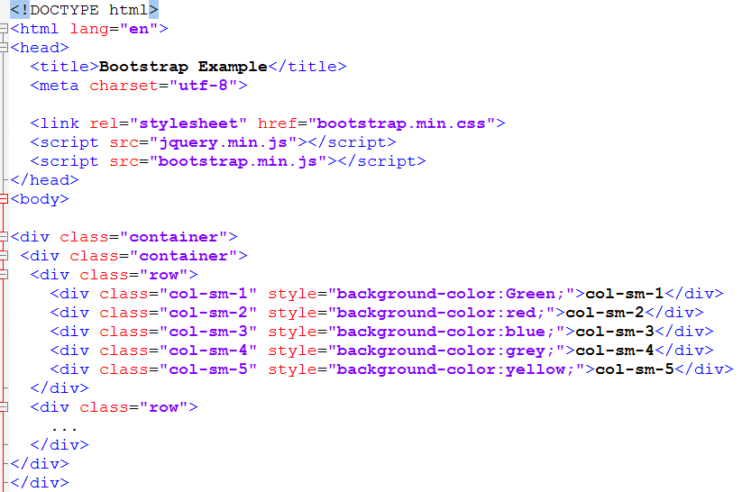
Bootstrap Grid Example

Slide 20
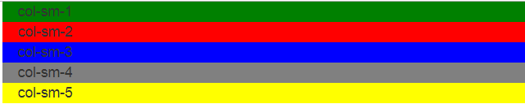
Bootstrap Grid Example
Output (code is written on Notepad)
After resizing page

Slide 21
Bootstrap rows and column
Row and column are bootstrap classes that helps to design a layout
Rows
Create vertical position with each other
Columns
Creates horizontal position with each other

Slide 22
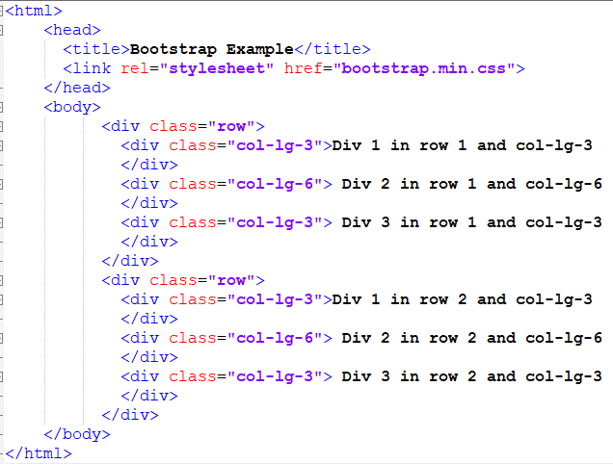
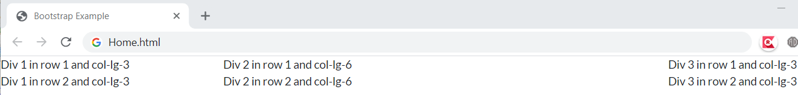
Example: Bootstrap rows and column

Slide 23
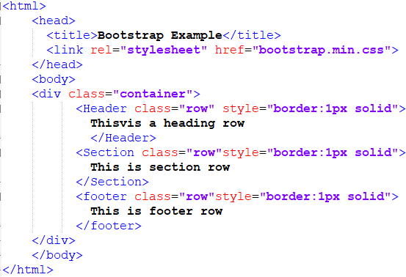
Example: Bootstrap rows and column
Imagine the output of following html

Slide 24
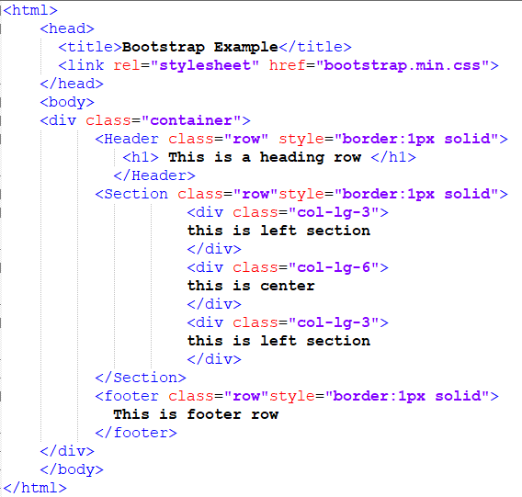
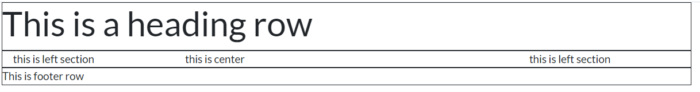

Slide 25
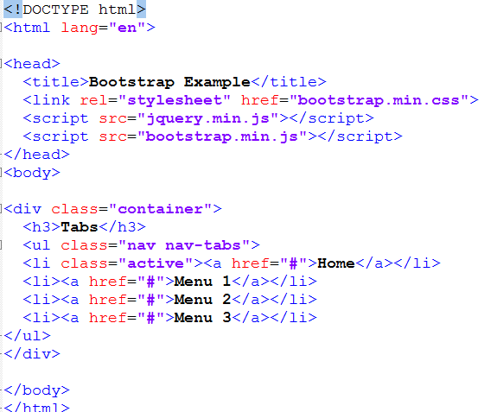
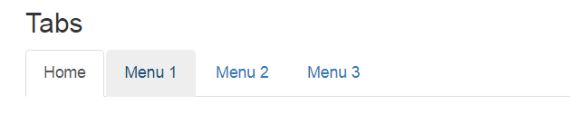
Adding horizontal menu
Bootstrap Tabs

Slide 26
Bootstrap CSS Example
Bootstrap Tabs

Slide 27
Bootstrap CSS Example
Bootstrap Pills
Pills are used to make a horizontal menu.
Pills are straight menu that looks like a horizontal table cells.

Slide 28
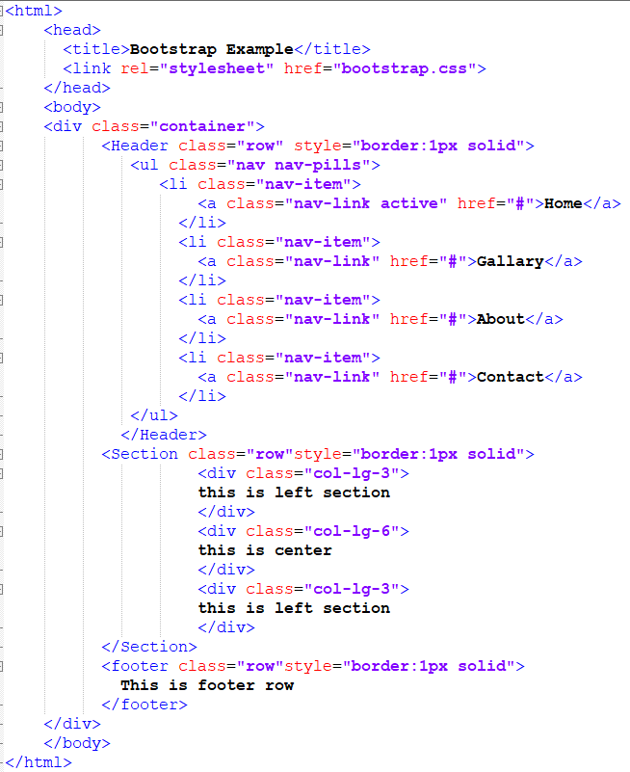
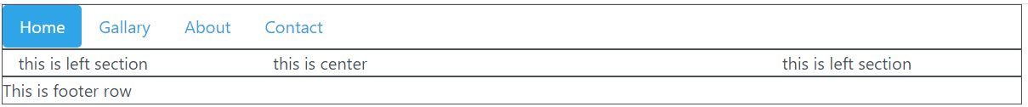

Slide 29
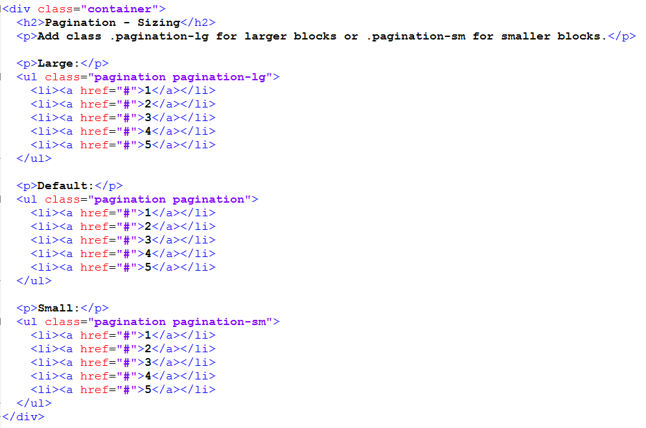
Adding Pagination to the page
Bootstrap Pagination

Slide 30
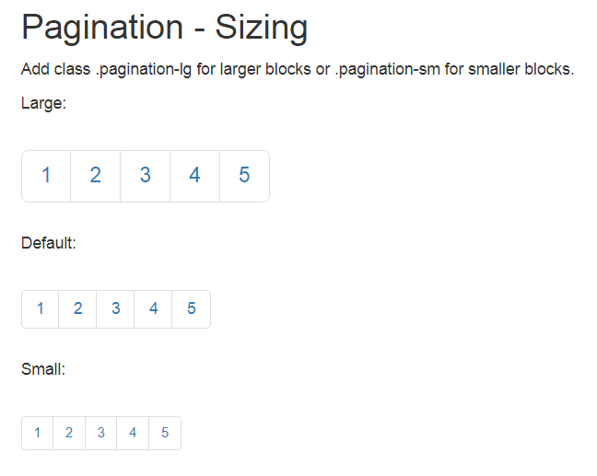
Bootstrap CSS Example
Bootstrap Pagination

Slide 31
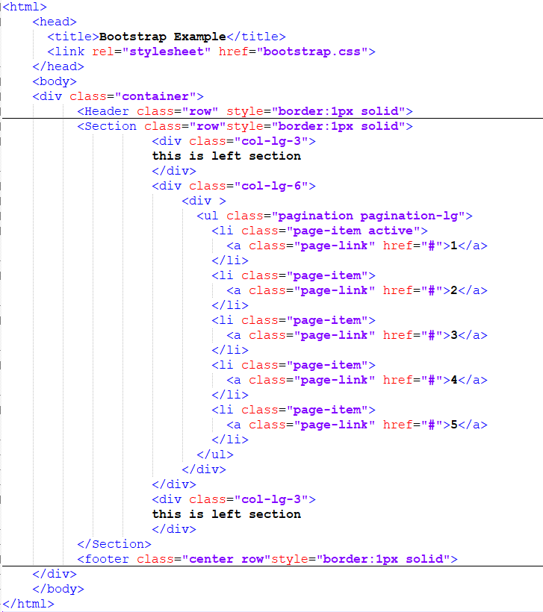
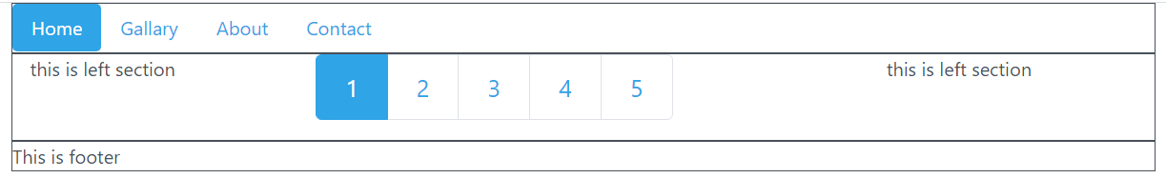

Slide 32
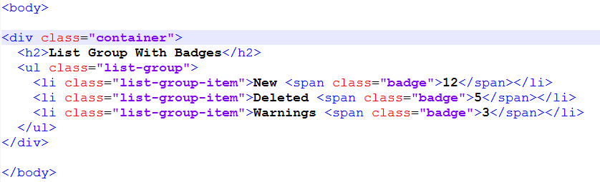
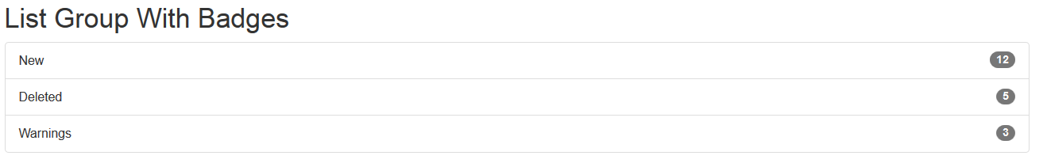
Adding list to the page
List Group Items

Slide 33
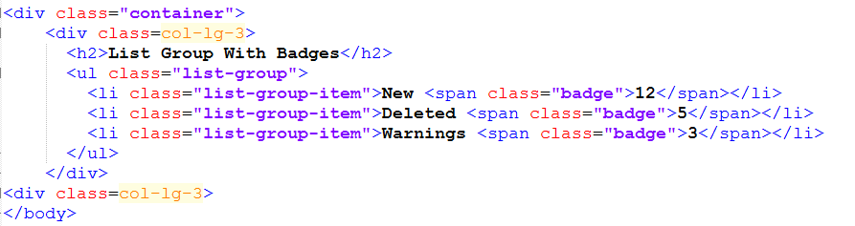
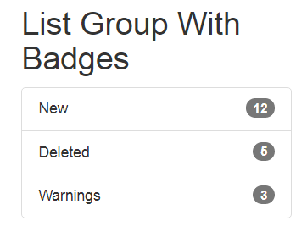
Bootstrap CSS Example
List group items with col-lg class

Slide 34
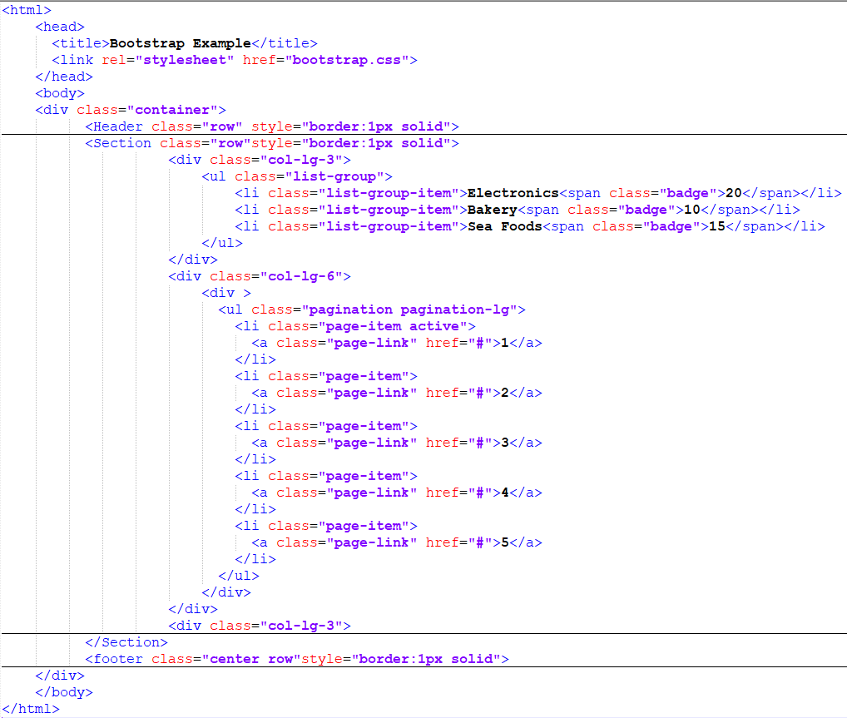
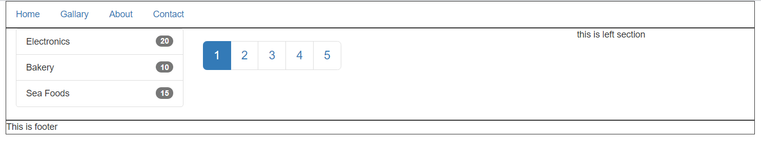

Slide 35
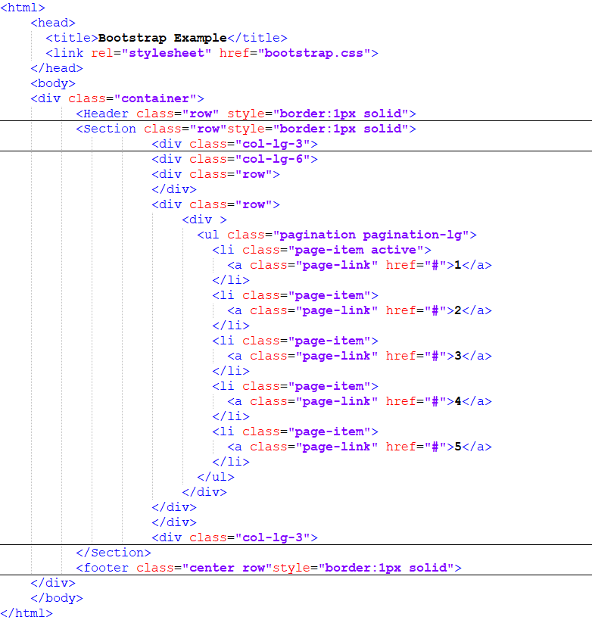
Create 2 rows in central column : col-lg-6

Slide 36
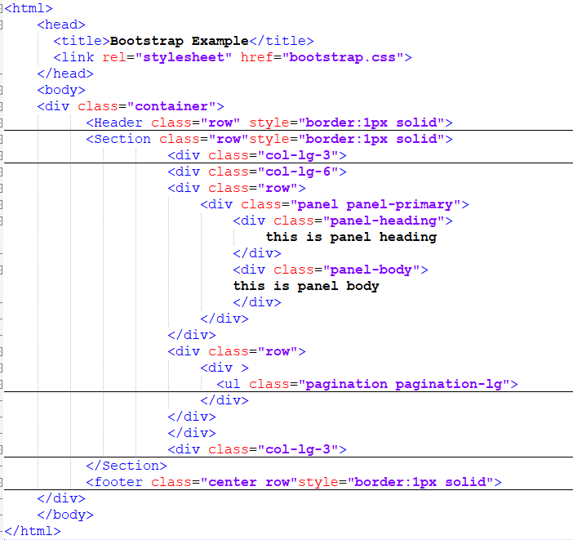
Create 2 rows in central column : col-lg-6

Slide 37
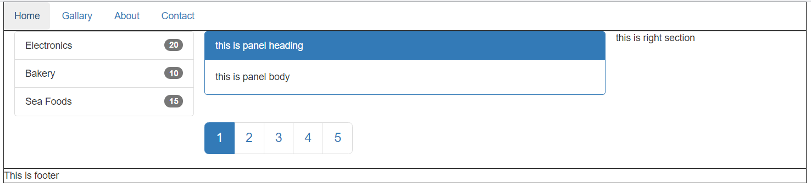

Slide 38
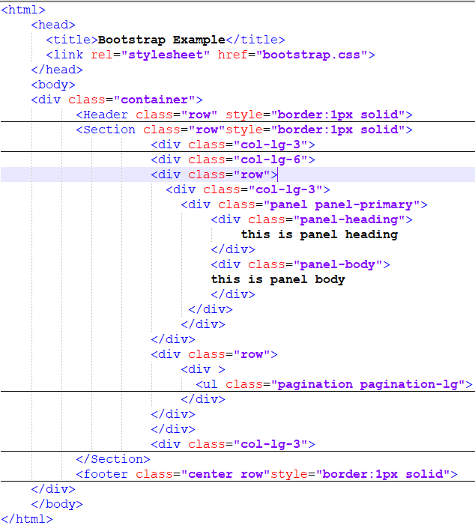
Place the panel-primary inside column of 3 indexes

Slide 39
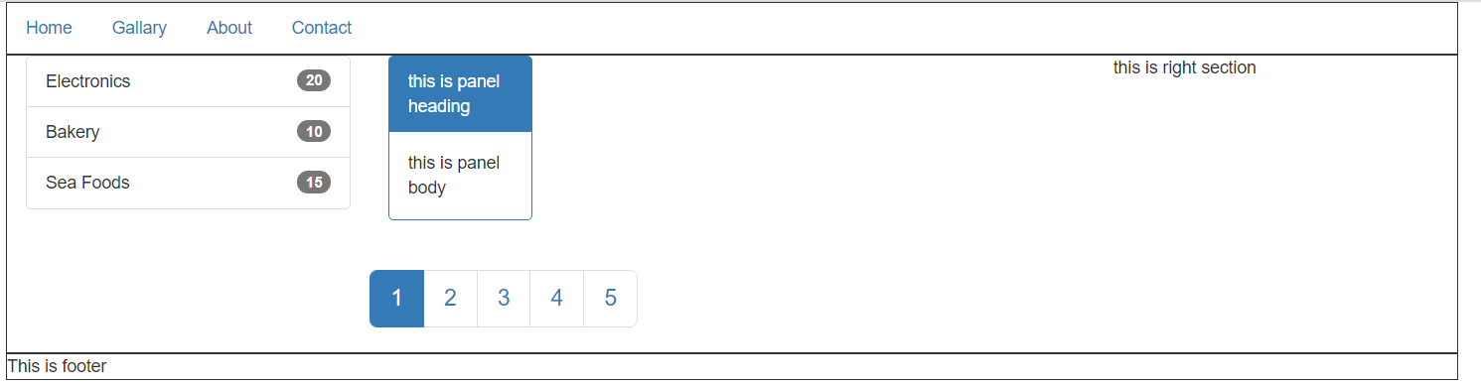

Slide 40
Bootstrap Example
Bootstrap CSS Buttons
Provides different types of button design. For example
See next slide

Slide 41
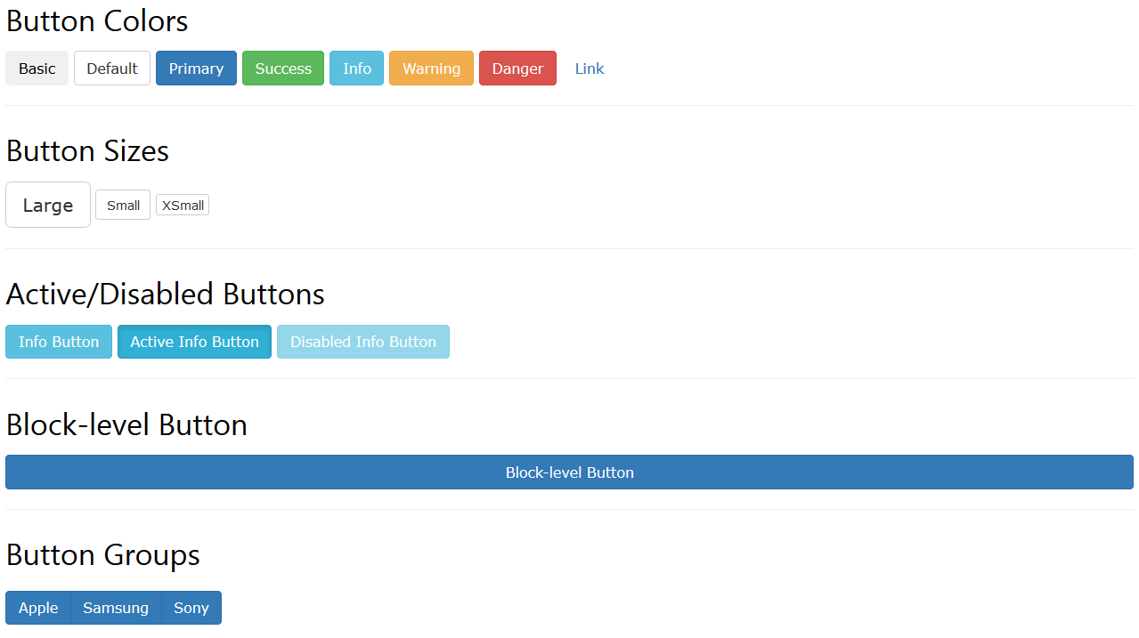
Bootstrap CSS Example

Slide 42
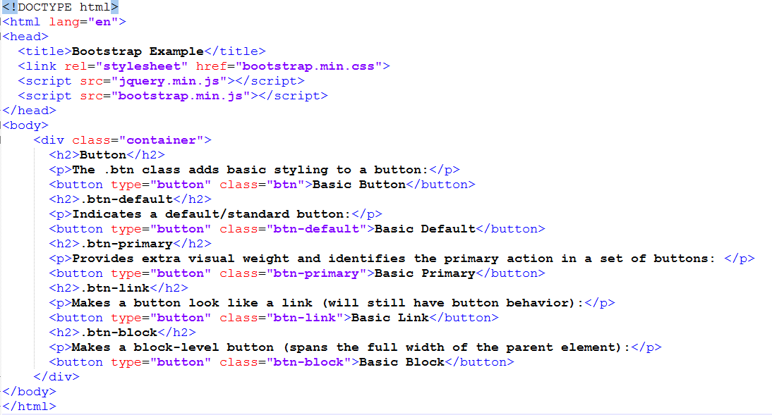
Bootstrap CSS Example

Slide 43
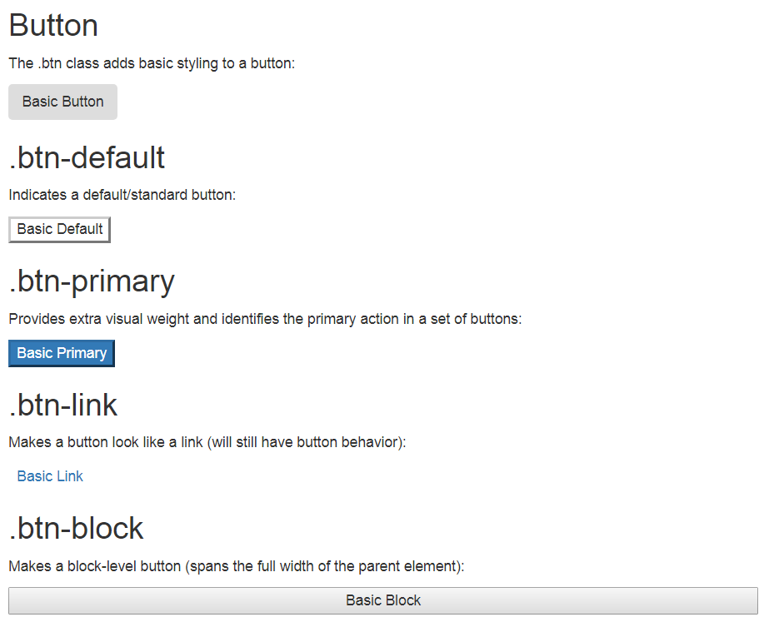

Slide 44


Bootstrap CSS Example
Bootstrap Images
Bootstrap image class provides different image styles. For example
Circle
Rounded Corner

Slide 45
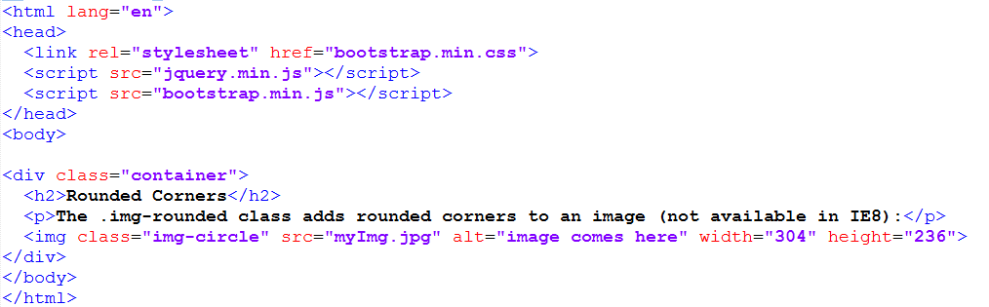
Bootstrap CSS Example
Rounded Corner Images

Slide 46
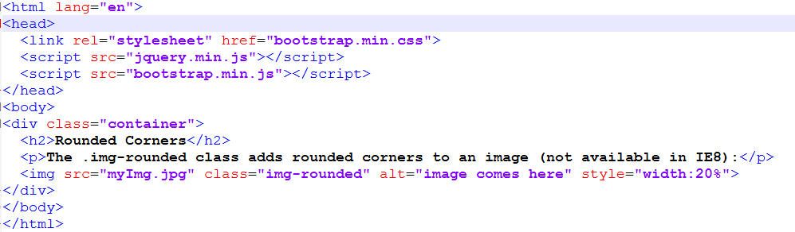
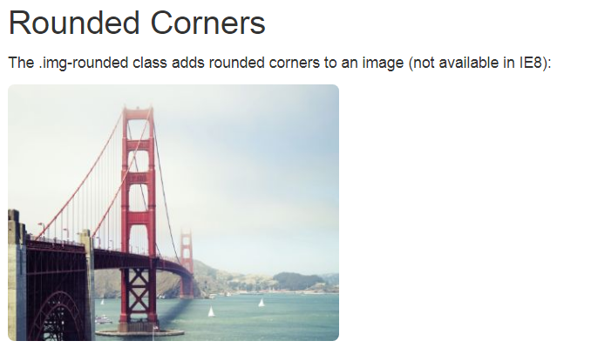
Bootstrap Example: Rounded corner img

Slide 47
Bootstrap CSS Example
Bootstrap Tabs

Slide 48
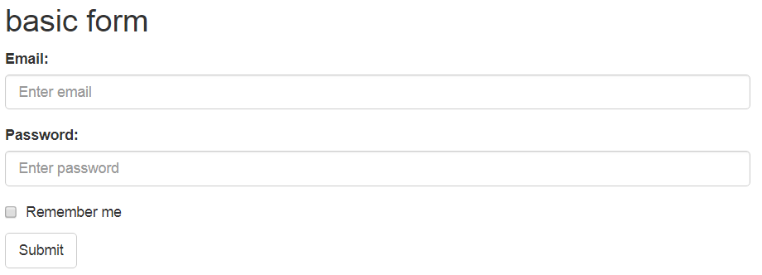
Bootstrap CSS Example
Bootstrap Form

Slide 49
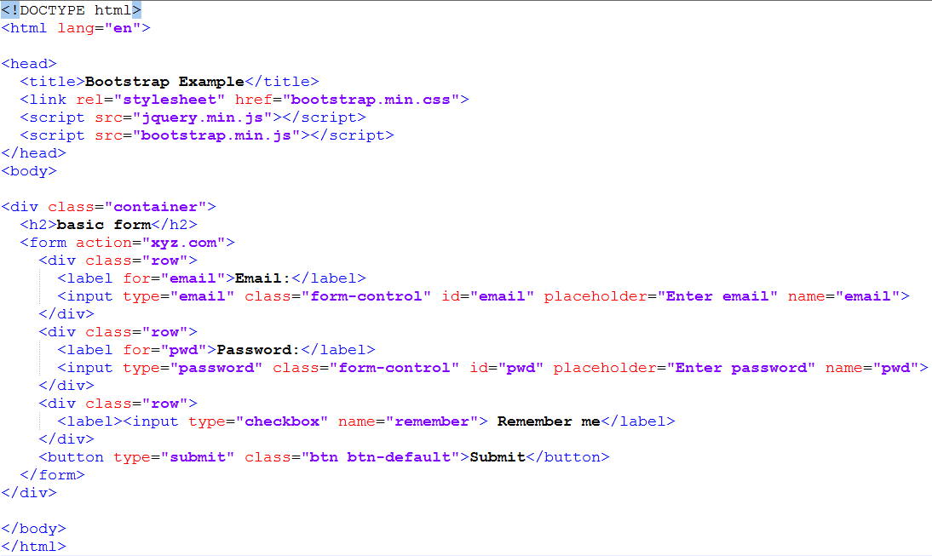
Bootstrap CSS Example

Slide 50
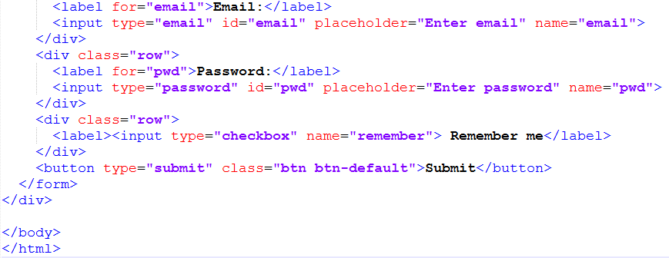
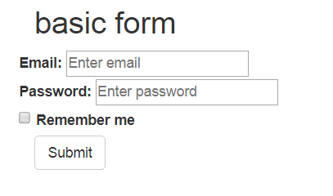
Bootstrap CSS Example
If you tried to remove form-control class, then

Slide 51
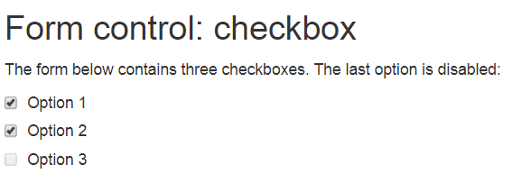
Bootstrap CSS Example
Checkboxes
Checkboxes are used if you want the user to select any number of options from a list of preset options.
The following example contains three checkboxes. The last option is disabled:

Slide 52
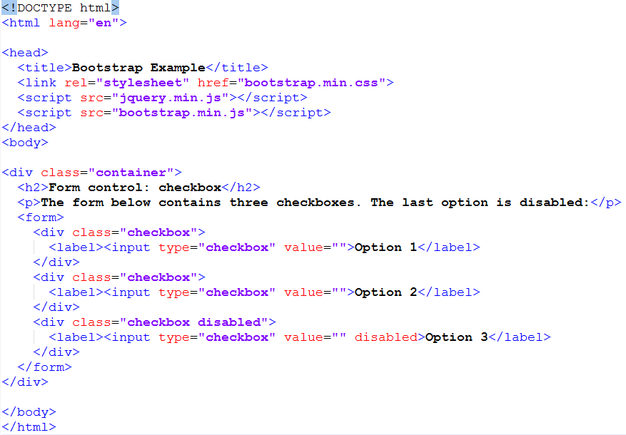
Bootstrap CSS Example

